Slide 1

Lecture-15
Data Structures
•
Binary
Tree s
Kartik Mathur

Slide 2

2
Any Doubts?

Slide 3
3
Binary Trees

Slide 4
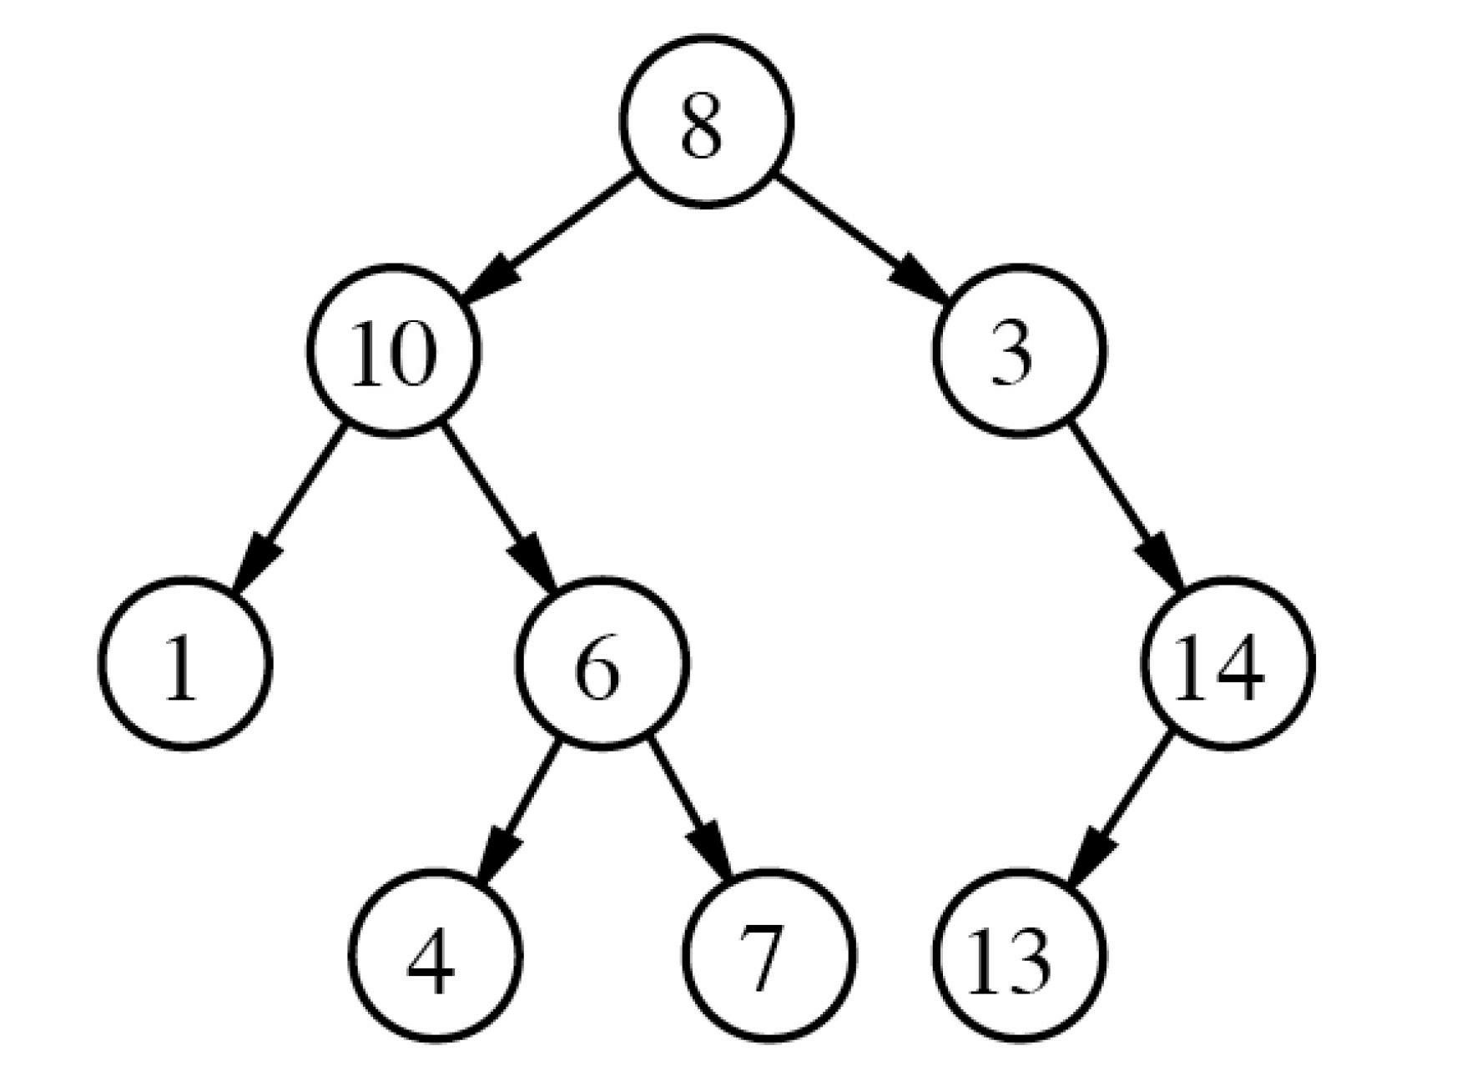
4
Binary Trees

Slide 5
5
Binary Tree Node
class node{
int data;
node* left;
node* right;
}

Slide 6
6
Input & Output
1.
Ta k e
Print
Input
2.

Slide 7
7
Lets discuss a problem
1. Count number of Nodes
Height
the
Find diameter
2.
of
tree
3.
of
a
binary
tree
4. Max Sum Problem by taking either child
or parent node in the sum

Slide 8
8
Your Turn
Find
1.
a
Mirror
node
in
Binary
Tr e e
2.
a binary
tree

Slide 9
9
Another Traversal for Binary Trees
Inorder
1.
Tr a v e r s a l
Preorder
Postorder
LevelOrder
2.
3.
4.
More Questions…

